Slide 1
Marketing Analytics
E-Learning – Rachit Chadha

Slide 2
The Data
About the Dataset
The data itself is generated based on e-learning website features and user behavior.
The data ranges from January 2017 to December 2018.
There are 13644 rows and 11 columns (features).
There are 1001 unique account IDs in the dataset.

Slide 3
Key Findings

Slide 4
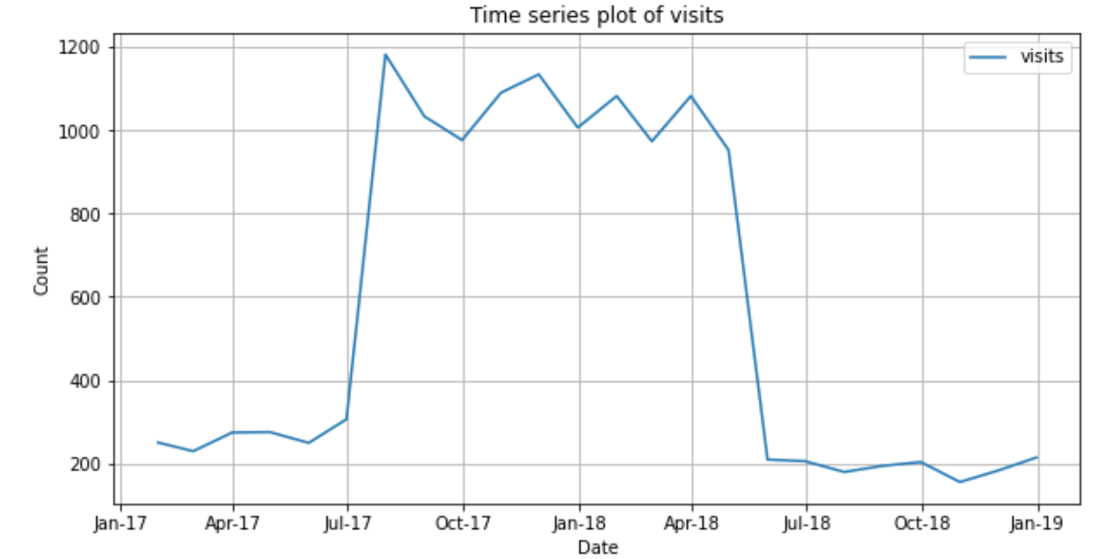
Rise in the number of visits between Aug’17 and May’18
Key Finding #1
We see a sharp rise in the number of visits in August 2017 and a sharp drop in the number of visits in May 2018.
Additionally, page views, searches, view time, etc. show similar trends.
Note: It would be beneficial to know the reasons behind the rise and fall of customer activity on the website.

Slide 5
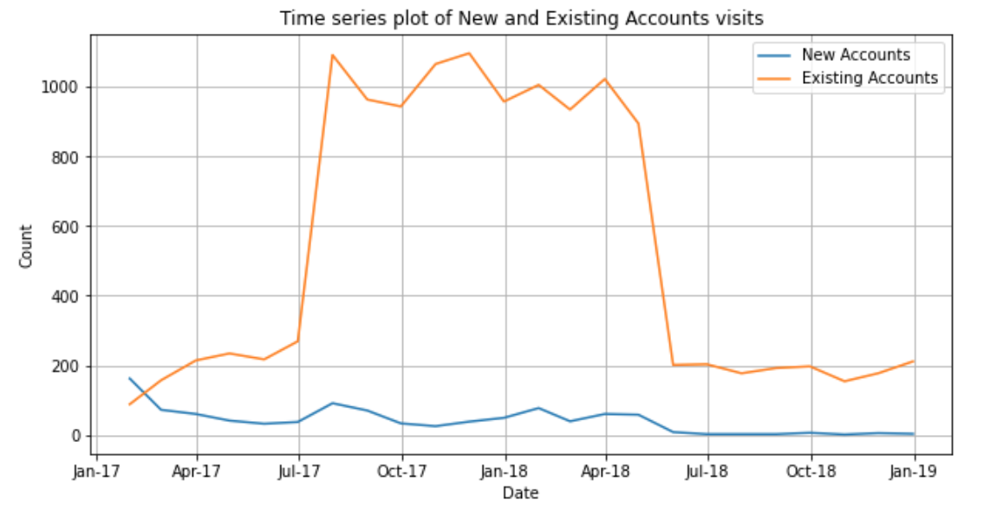
Rise in the number of existing customers’ visits but no change for new customers* in Aug’17 to May’18
Key Finding #2
We see a sharp rise in the number of existing customers’ visits in August 2017 and a sharp drop in the number of visits in May 2018.
However, there is no significant change in the activity level by new users within the date range.
This signifies that the platform could target new customers.
Note: Why is the platform unable to acquire a significant number of new customers? For existing customers, why is there a sharp rise and drop – why does their loyalty waiver after May’18?
* New Customers indicate customers who have not visited the platform before

Slide 6
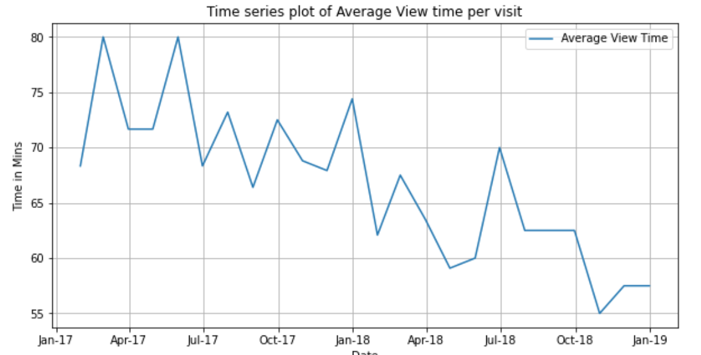
There is a downward trend in the average view time per visit
Key Finding #3
We observe a downward trend in the average view time per visit by users over the date range.
This implies that users are spending lesser time on the platform viewing videos per visit as compared to before.
Note: Why are the customers spending less time as compared to before – are they losing interest? Do we need to produce more engaging content?

Slide 7
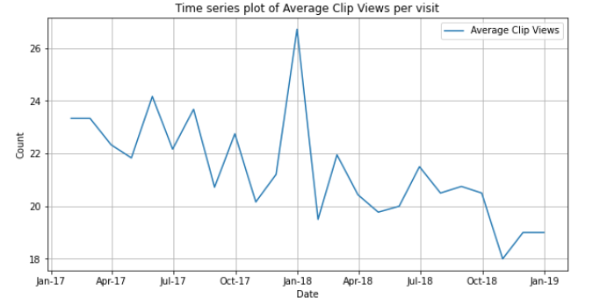
There is a downward trend in the average number of clips viewed per visit
Key Finding #4
We observe a downward trend in the average number of clips viewed per visit by users over the date range. This implies that users are watching fewer clips on each visit than before.
Further, the duration of the clips viewed has not increased*, which begs the question of why is the clip viewership per visit going down?
We also notice a one-off spike in January’18 for average clips viewed.
Note: Have the clips become less interesting? Or is there a limited amount of engaging content which is exhausted over time?
*For more details, please refer to Appendix 1

Slide 8
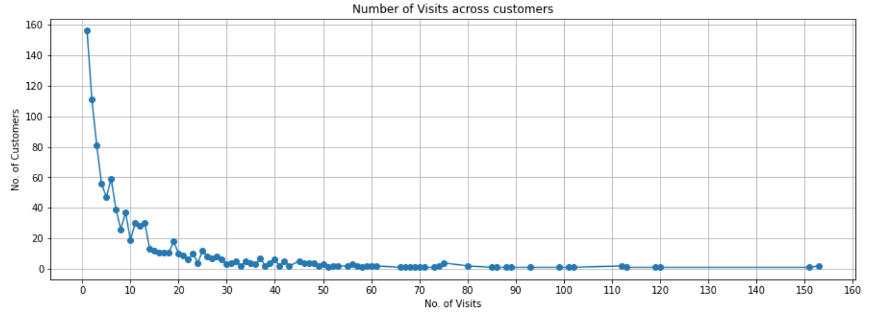
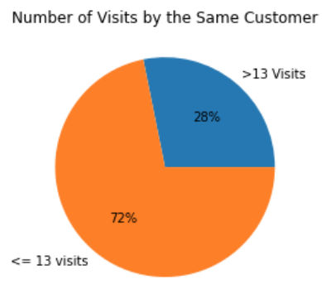
Majority of users visit less than 13 times
Key Finding #5
16% of users visit the platform only once. 45% of users visit only 5 or fewer times*.
72% of users do not visit the platform more than 13 times, whereas 28% of users visit the platform 14 or more times within the date range.
Note: Why is the majority of user base not visiting more than 13 times? How can we increase customer retention?
*For more details, please refer to Appendix 2

Slide 9
Recommendations & Conclusion

Slide 10
CONCLUSION
There has been no significant increase in the number of new customers acquired. Thus, there is a potential for marketing strategies to focus on acquiring new customers. This can be done through giveaways, marketing campaigns, building new partnerships and improving SEO strategies, etc.
On average, the number of clips viewed and view time per visit has gone down. An in-depth analysis needs to be conducted to understand the reasons behind this. It could be that there is an exhaustive amount of engaging content. Thus, new interesting content can be provided. Customer surveys can be conducted to increase engagement as well as understand what the learners are looking for.
There was a sharp rise in number of visits, clips viewed, view time and overall learner engagement on the platform in August 2017. The causes behind this must be analyzed and if possible, strategies based on this should be implemented.
There was a sharp fall in number of visits, clips viewed, view time and overall learner engagement on the platform in May 2018. We must find out what happened and work towards preventing it in the future.
There is a huge potential to better understand user behavior and develop marketing strategies accordingly by collecting more data from the platform. This sort of data can be collected using tools like google analytics, google tag manager, etc.

Slide 11
APPENDIX

Slide 12
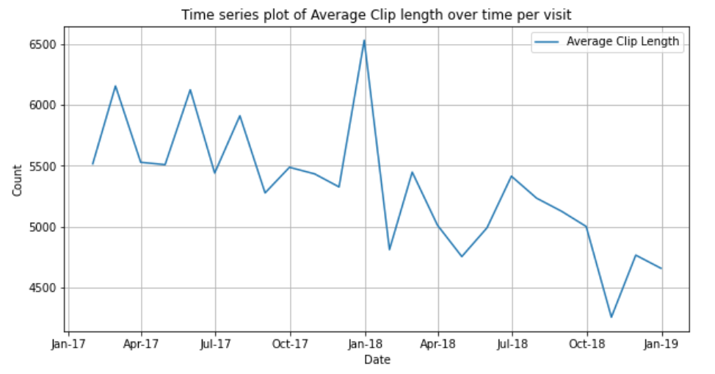
APPENDIX: 1
Average duration of clips viewed per visit has decreased over time.

Slide 13
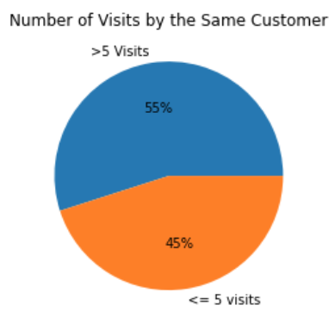
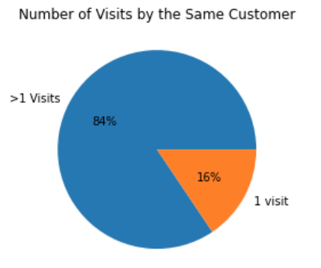
APPENDIX: 2
% of customers who visit the platform <=5 times
% of customers who visit the platform 1 time

